Slide 1





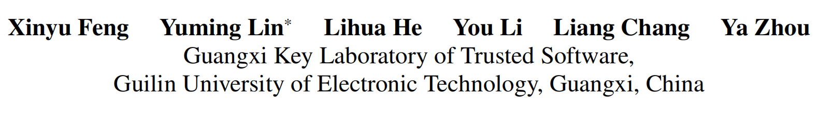





ATAI
Advanced Techniqueof Artificial Intelligence
ATAI
ChongqingUniversity _{AdvancedTechniqueof}
of Technology Artificial Intelligence
Chongqing University of
Technology
Chongqing University ^{ATAI}
_{of Technology} Advanced Techniqueof
Artificial Intelligence
Chongqing University of Technology
Chongqing University of Technology
Knowledge-Guided Dynamic Modality Attention Fusion Framework for Multimodal Sentiment Analysis
Code:None
2024.10.24 •ChongQing
—— EMNLP 2024
Reported by YaoChen Li
1

Slide 2

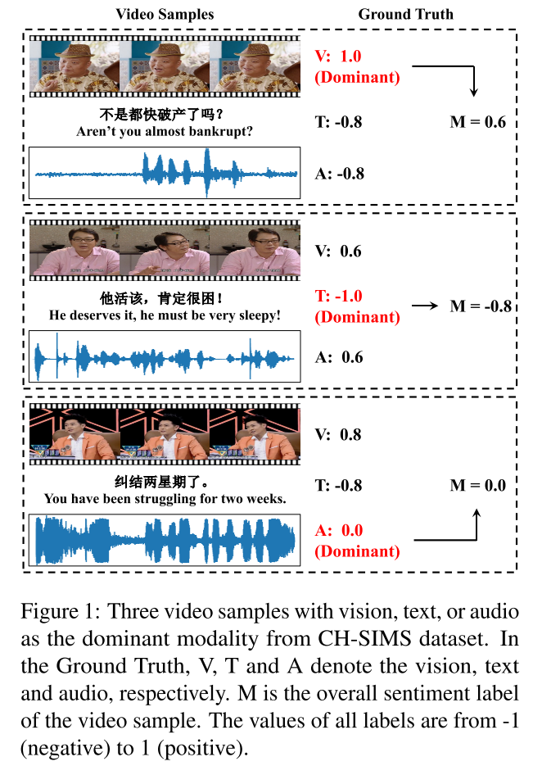
ATAI
AdvancedTechniqueof
Artificial Intelligence
ATAI
ChongqingUniversity _{AdvancedTechniqueof}
of Technology Artificial Intelligence
ChongqingUniversity of Technology
Motivation
Previous methods focus on equally treating the contribution of each modality or statically using text as the dominant modality to conduct interaction, which neglects the situation where each modality may become dominant.

Slide 3

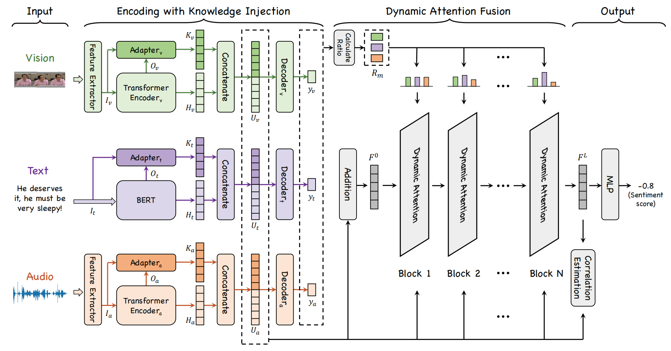
ChongqingUniversity of Technology
ATAI
AdvancedTechniqueof
Artificial Intelligence
ATAI
ChongqingUniversity _{AdvancedTechniqueof}
of Technology Artificial Intelligence
Overview

Slide 4
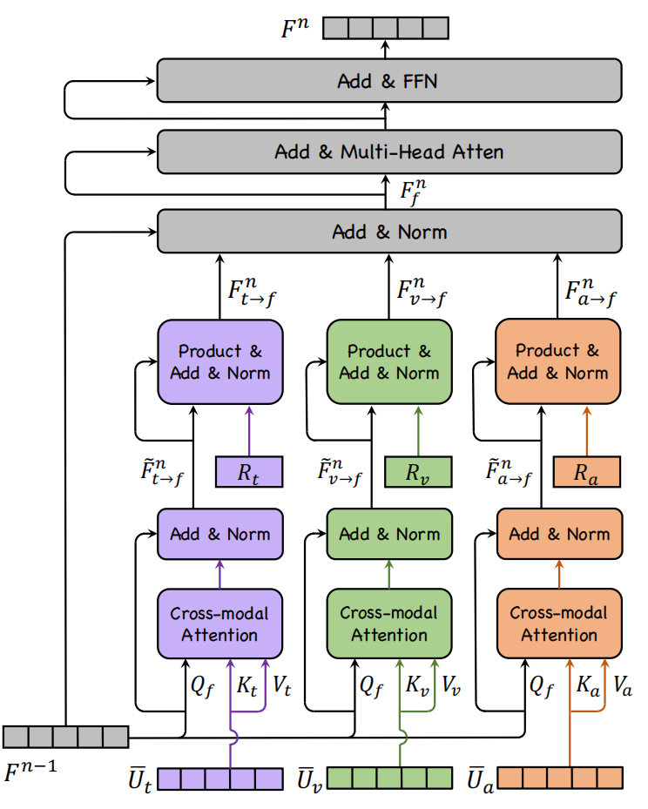
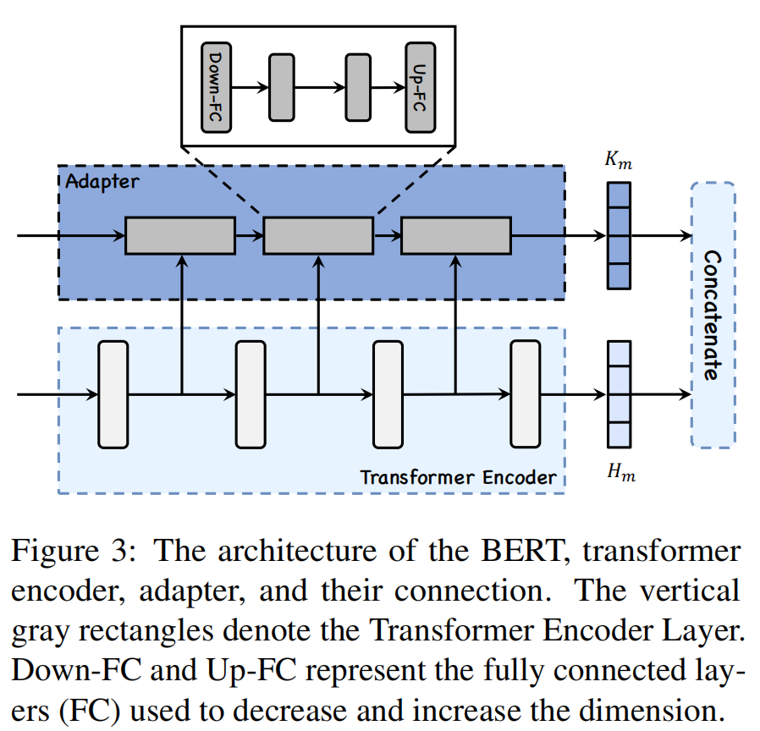
ChongqingUniversity of Technology
ATAI
AdvancedTechniqueof
Artificial Intelligence
ATAI
ChongqingUniversity _{AdvancedTechniqueof}
of Technology Artificial Intelligence
Overview

Slide 5

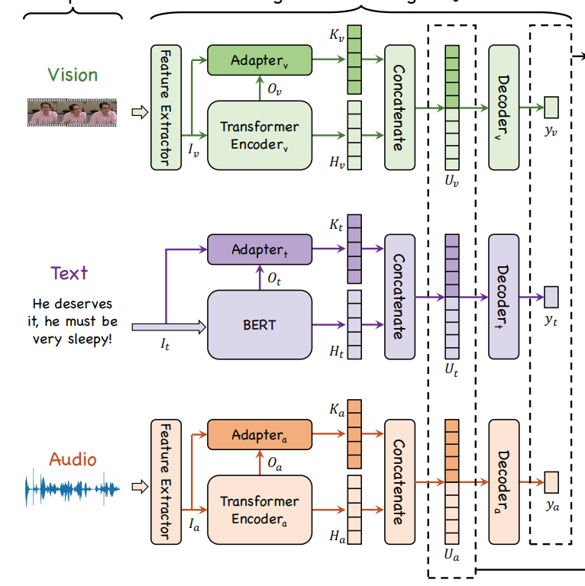






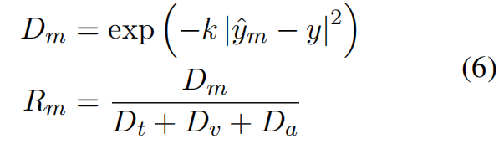
ChongqingUniversity of Technology
ATAI
AdvancedTechniqueof
Artificial Intelligence
ATAI
ChongqingUniversity _{AdvancedTechniqueof}
of Technology Artificial Intelligence
Method

Slide 6





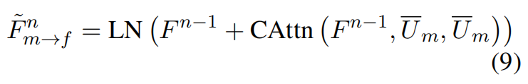
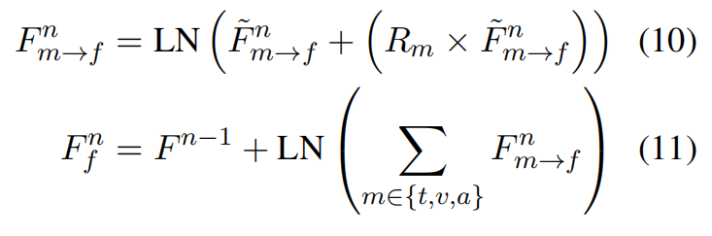
ChongqingUniversity of Technology
ATAI
AdvancedTechniqueof
Artificial Intelligence
ATAI
ChongqingUniversity _{AdvancedTechniqueof}
of Technology Artificial Intelligence
Method

Slide 7
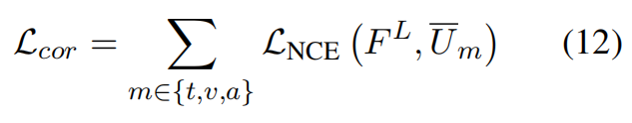
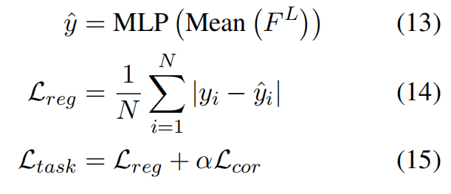
ChongqingUniversity of Technology
ATAI
AdvancedTechniqueof
Artificial Intelligence
ATAI
ChongqingUniversity _{AdvancedTechniqueof}
of Technology Artificial Intelligence
Method

Slide 8

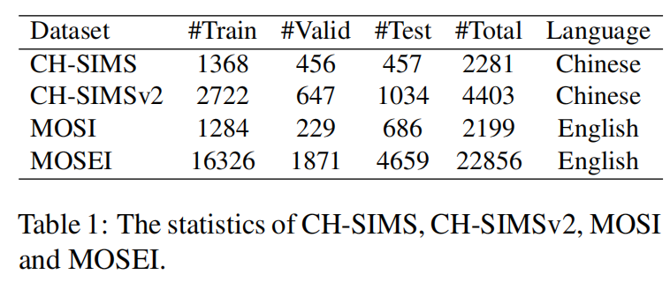
ATAI
AdvancedTechniqueof
Artificial Intelligence
ATAI
ChongqingUniversity _{AdvancedTechniqueof}
of Technology Artificial Intelligence
ChongqingUniversity of Technology
Experiments

Slide 9
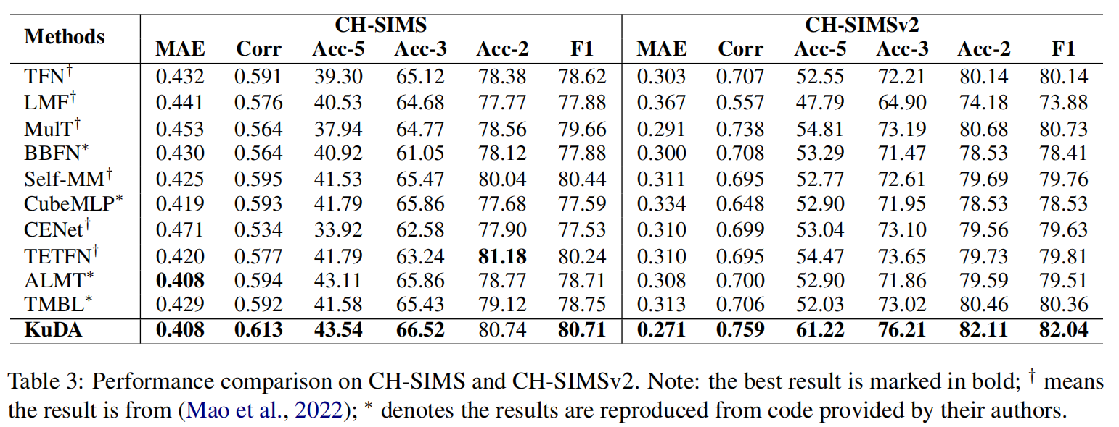
ATAI
AdvancedTechniqueof
Artificial Intelligence
ATAI
ChongqingUniversity _{AdvancedTechniqueof}
of Technology Artificial Intelligence
ChongqingUniversity of Technology
Experiments

Slide 10
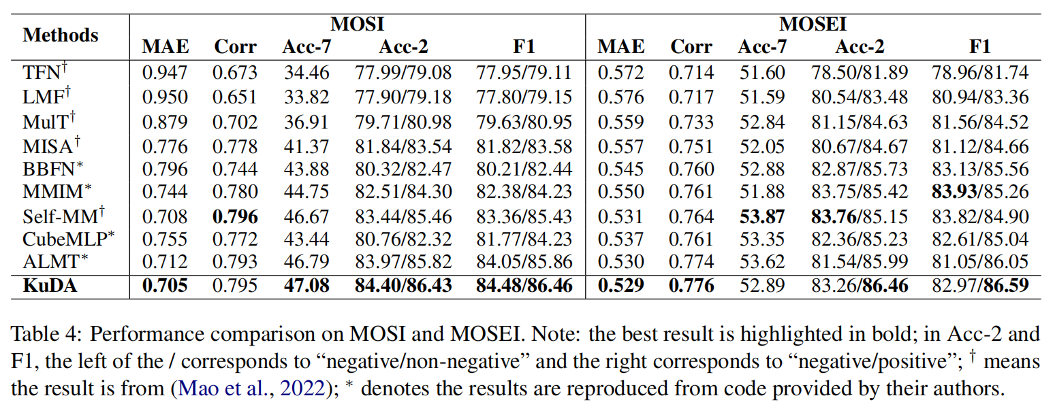
ChongqingUniversity of Technology
ATAI
AdvancedTechniqueof
Artificial Intelligence
ATAI
ChongqingUniversity _{AdvancedTechniqueof}
of Technology Artificial Intelligence
Experiments

Slide 11
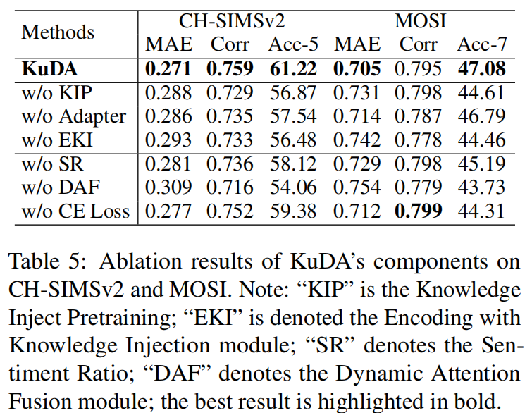
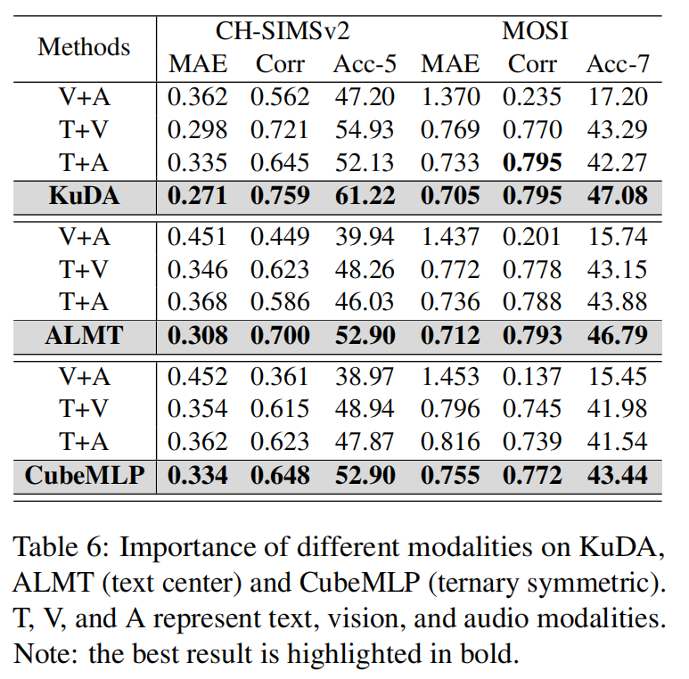
ChongqingUniversity of Technology
ATAI
AdvancedTechniqueof
Artificial Intelligence
ATAI
ChongqingUniversity _{AdvancedTechniqueof}
of Technology Artificial Intelligence
Experiments

Slide 12
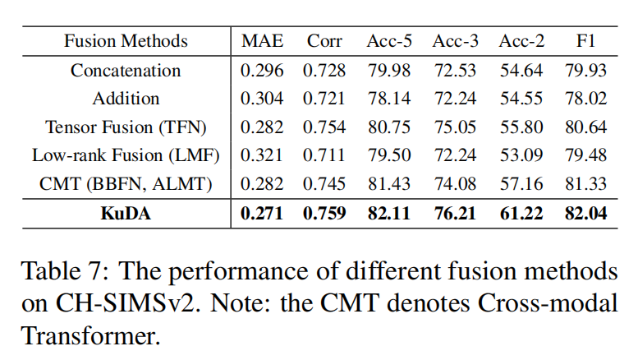
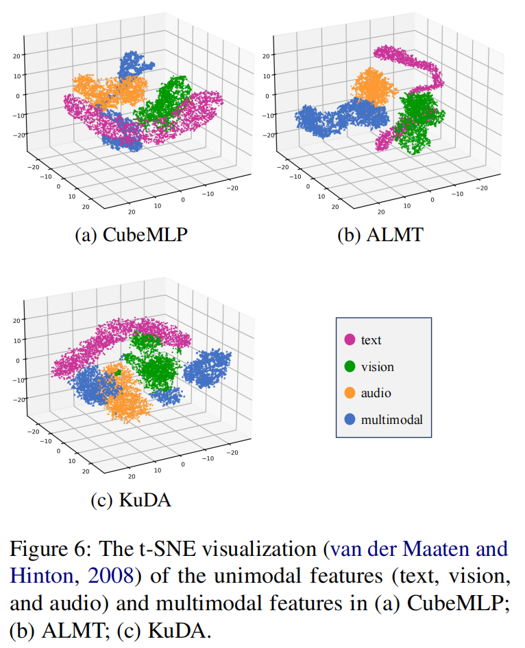
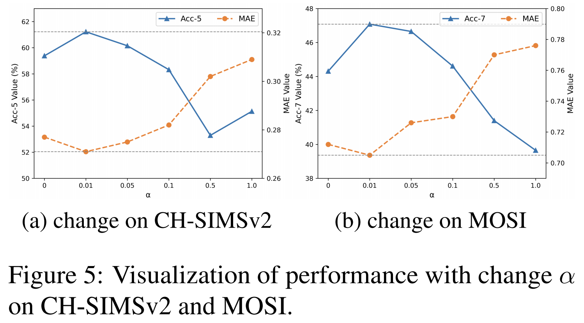
ChongqingUniversity of Technology
ATAI
AdvancedTechniqueof
Artificial Intelligence
ATAI
ChongqingUniversity _{AdvancedTechniqueof}
of Technology Artificial Intelligence
Experiments

Slide 13
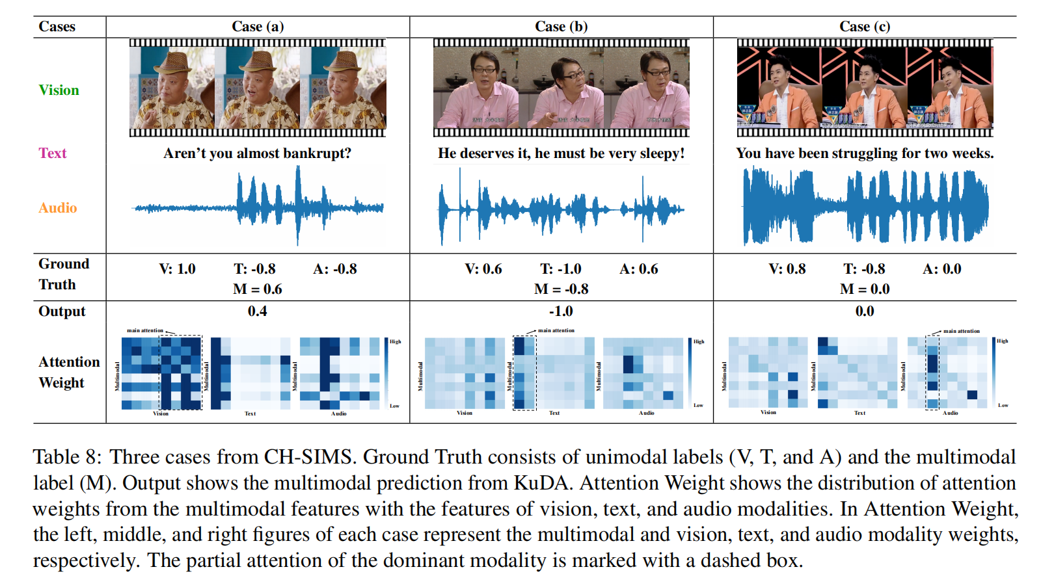
ChongqingUniversity of Technology
ATAI
AdvancedTechniqueof
Artificial Intelligence
ATAI
ChongqingUniversity _{AdvancedTechniqueof}
of Technology Artificial Intelligence
Experiments

Slide 14


ChongqingUniversity of Technology
ATAI
AdvancedTechniqueof
Artificial Intelligence
ATAI
ChongqingUniversity _{AdvancedTechniqueof}
of Technology Artificial Intelligence
Thanks!

